Slide 1

Final Project
How much energy will a building consume?
Tamara Baybachov 308240936
Ron Gershburg 313164766

Slide 2

The Method
Data Exploration
Pre-Processing
Training
Prediction

Slide 3
Data Exploration
In order to do pre-processing we have to observe the data and see its disadvantages.
To that end, we visualized the data with different plots.
In the next page we can see 2 different plots that represent missing data. Data in training set and data in test set.
We can see that there are huge amount of missing data in :
Floor_count
Year_built
Cloud_coverage
Precip_depth_1_hr

Slide 4
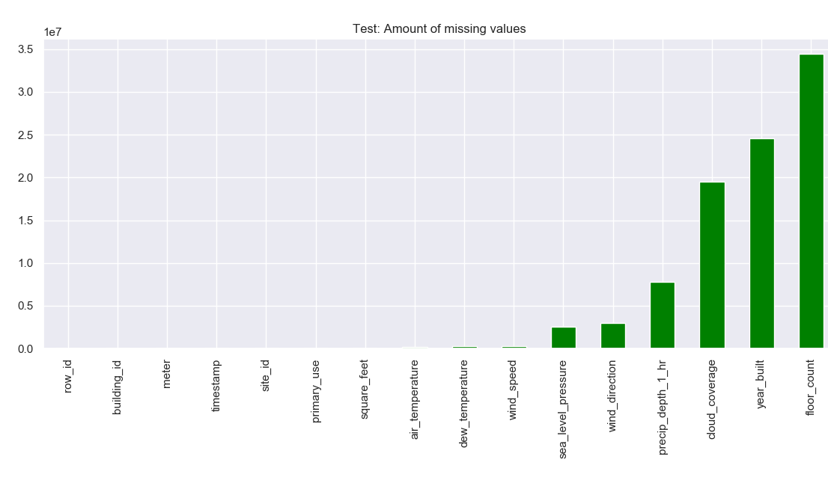
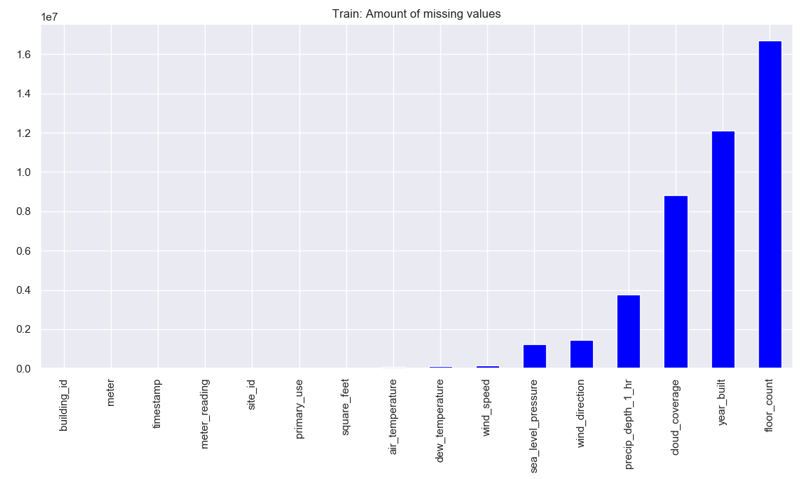
Missing Data

Slide 5
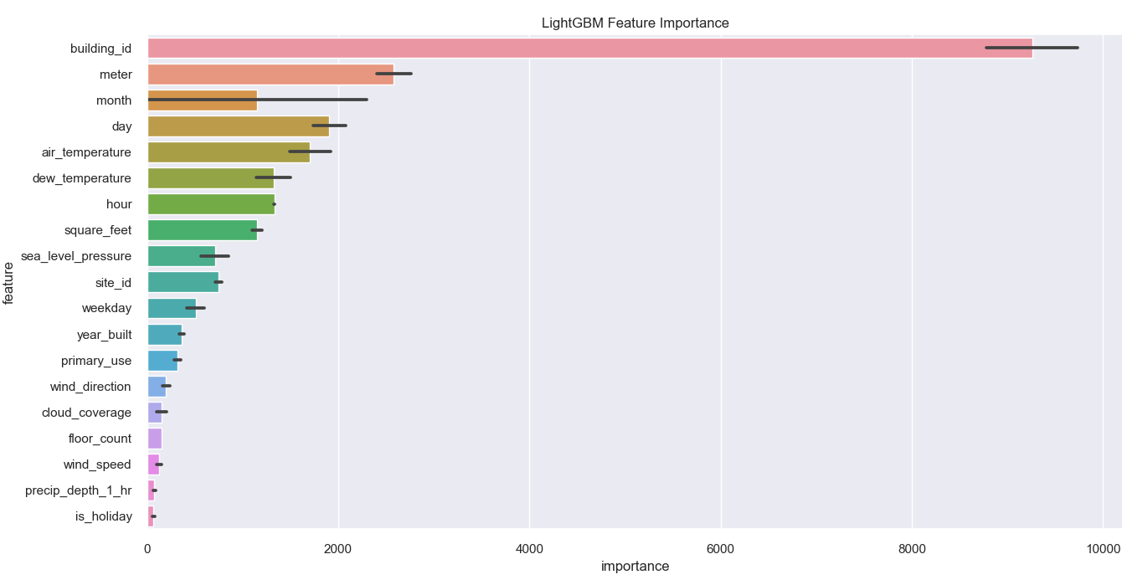
Feature Importance
After running the model(will be explained later) we could get a graph that rates the importance of each feature. This method helped us choose the most important features and drop the rest.
Importance is calculated by counting the number of times that a feature is used in the model.

Slide 6
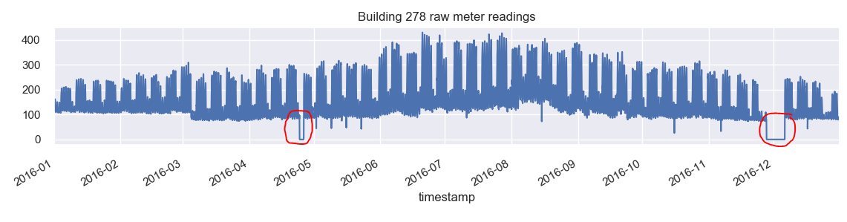
Wrong Meter Readings And Outliers
By observing the data we could see anomalies in meter readings of different meteorological sites.
In addition we could see that those wrong readings originated in meteorological sites(in the next slide we see that all the buildings in site 0 have the same kind of anomaly).
There are many outliers almost in every meteorological site, an example of a wrong reading can be seen in the graph below:

Slide 7
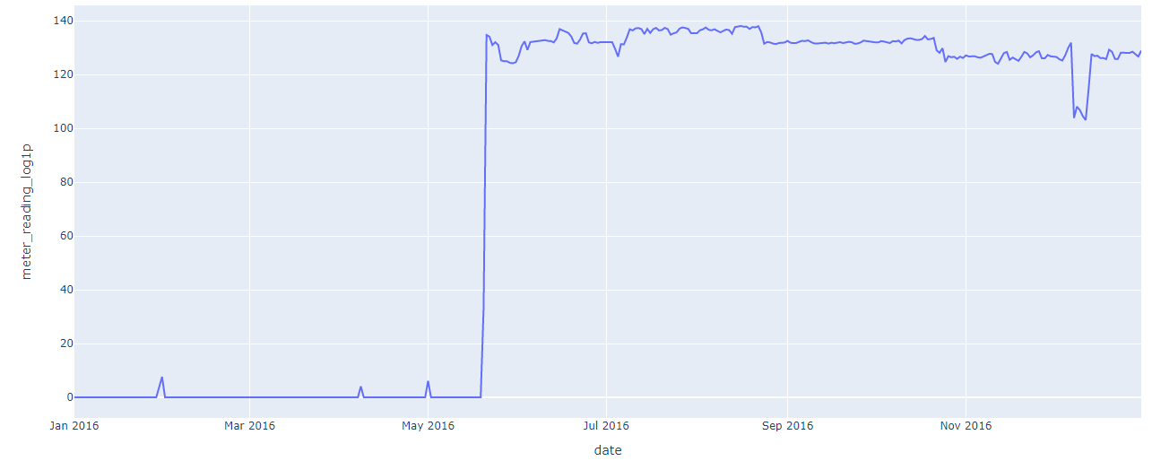
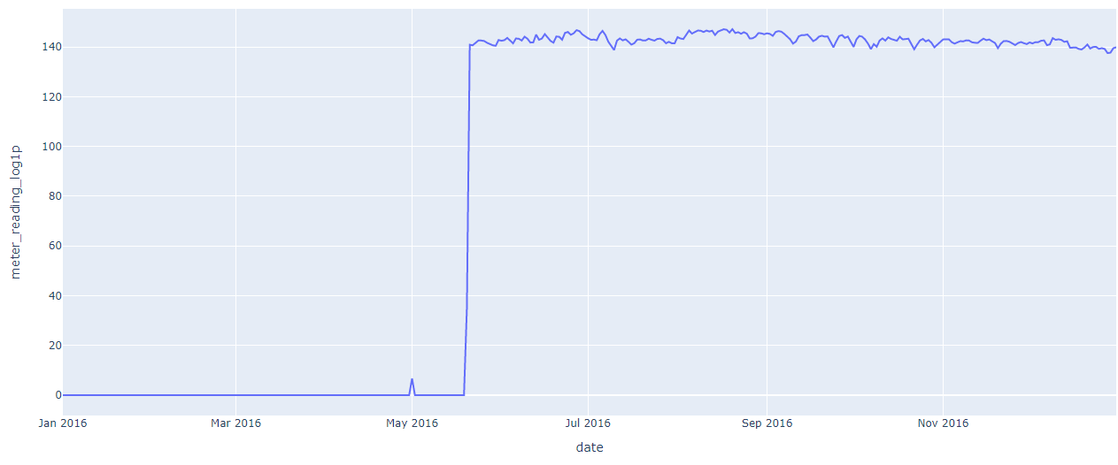
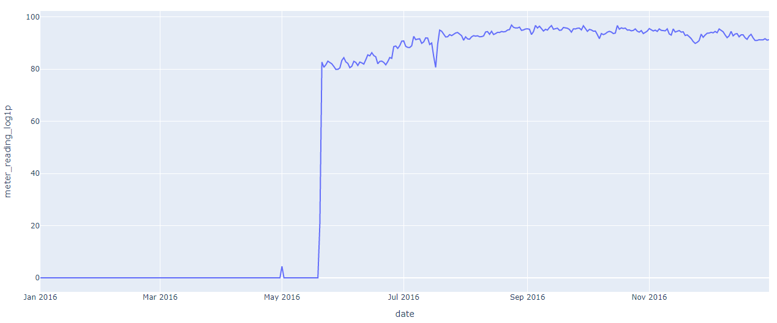
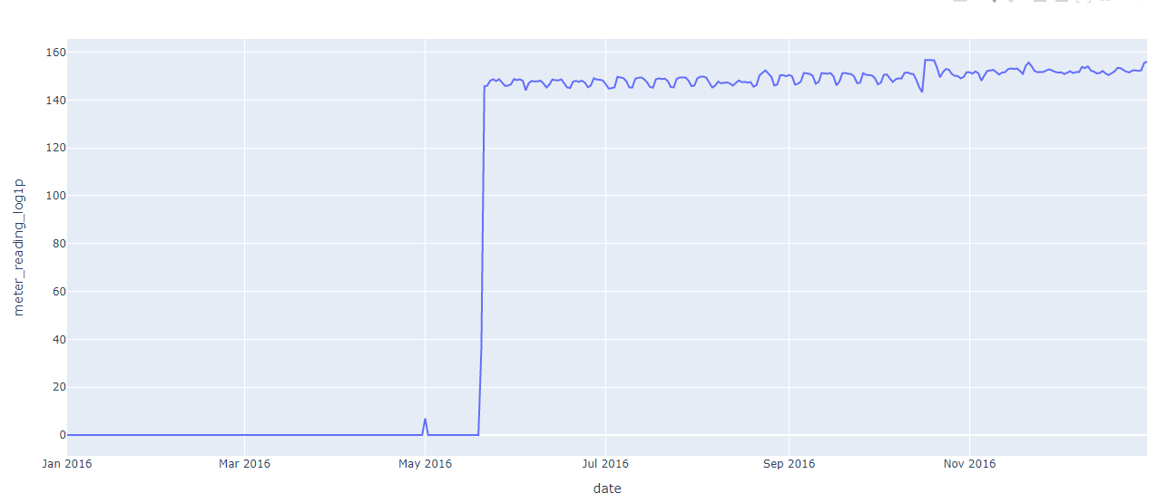
Wrong Meter Readings And Outliers
Site 0 readings
Building id = 0
Building id = 140
Building id = 50
Building id = 30

Slide 8
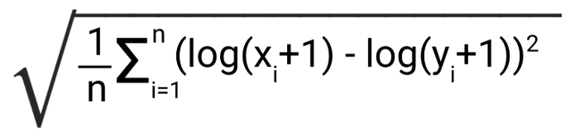
Pre-Processing
In the beginning we got 3 different datasets : train/test , weather_train / weather_test, building_metadata. In order to do further pre-processing and model training we merged the datasets(train + weather_train + building_metadata and test + weather_test + building_metadata).
As mentioned in the previous slides, there are many outliers that have to be removed in order to enhance performance of the model. Thus we went through every site and removed the relevant outliers manually.
Score in Kaggle is calculated by RMSLE: In order to make our loss function RMSLE we have to apply log(1+p) on our target variable and run the model with RMSE loss function.
We dropped features with low importance or features that worsened the performance of our model. Dropped features are the following:
Timestamp, sea_level_pressure, wind_direction, windspeed, cloud_coverage

Slide 9
Pre-Processing
We added new features in order to enhance model performance, we added few features that are based on the timestamp feature. Features such as:
Hour – the hour that the sample was recorded in the day(0 to 23).
Day – day in the month
Month
Weekday – day in the week ( Monday – 0 and Sunday – 6 )
In addition we added holidays and a Boolean feature which is true when it is a holiday and false when it’s not. Holidays can effect energy consumption in buildings since most people aren’t working. The problem with this feature is that the holidays were calculated according to Christian holidays only(we can’t ensure that those holidays are relevant to all sites).
We made a list of categorical features for LGBM categorical input.
building_id, site_id, meter, primary_use, hour , weekday , month , day.

Slide 10
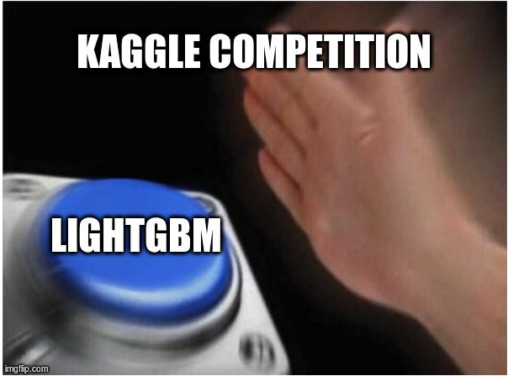
Training
To train our model we used Light Gradient Boosting Model(LGBM) framework which implements Gradient Boost Decision Tree (GBDT).
LGBM is a gradient boosting framework that uses tree based learning algorithm.
Why did we use LGBM and GBDT?
In our assignment we got enormous datasets(million of rows) that we have to pre-process and train. LGBM can handle the large size of data and takes lower memory to run.
LGBM focuses on accuracy of results
GBDT can get better performance than random forest if we choose the right parameters.

Slide 11

Training Choosing Parameters
LGBM has more than 100 parameters, we changed some of them ( the rest got default values) :
feature_fraction - 0.85 was selected. 0.85 feature fraction means LGBM will select 85% of parameters randomly in each iteration for building trees.
reg_lambda - specifies L2 regularization. We chose λ = 4 L$\left(x,y\right)=\sqrt{\frac{1}{n}\sum_{i=1}^{n}{{\left(x_{i}−y_{i}\right)}^{2}}}$ + λ*$\sum_{i=1}^{n}{{\left(θ_{i}\right)}^{2}}$ higher λ makes the model simpler and avoids overfitting.
learning_rate - This determines the impact of each tree on the final outcome. GBM works by starting with an initial estimate which is updated using the output of each tree. The learning parameter controls the magnitude of this change in the estimates( we chose it to be 0.05).
num_leaves: number of leaves in full tree . We chose it to be 30(big number is used for accuracy but might overfit the data so optimum should be found)
Metric – specifies loss for model building. We used Root Mean Square Error(RMSE) in order to make the loss function identical to the one in Kaggle score evaluation.

Slide 12

K Cross Validation and Prediction
The amount of data in the current competition is huge. Therefore we could split it by using k cross validation and train k different models ( those models differ by data only).
After we trained those models(k models) we used them on the given test data(from Kaggle) to predict their meter readings. This action gave us k different predictions.
We applied $e^{p}−1$ (inverse to log(1+p)) , summed those predictions and divided them by k in order to get our final prediction.
In order to choose the value of k we ran different predictions with varying values of k. Our best prediction score was given by k = 5.
Meter reading data from the beginning of 2017 to the end of 2018 was used as test data(was handed to us in Kaggle).
Score was evaluated in the competition by Root Mean Squared Logarithmic Error(RMSLE).

Slide 13
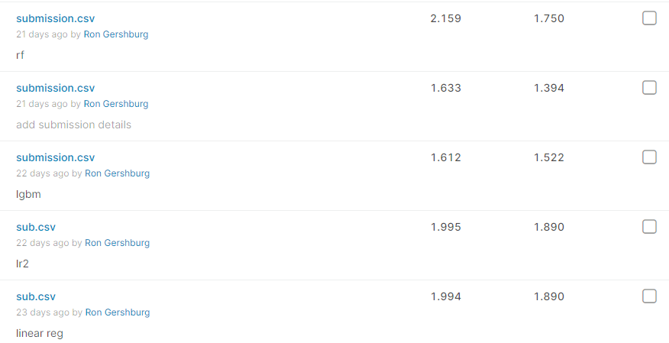
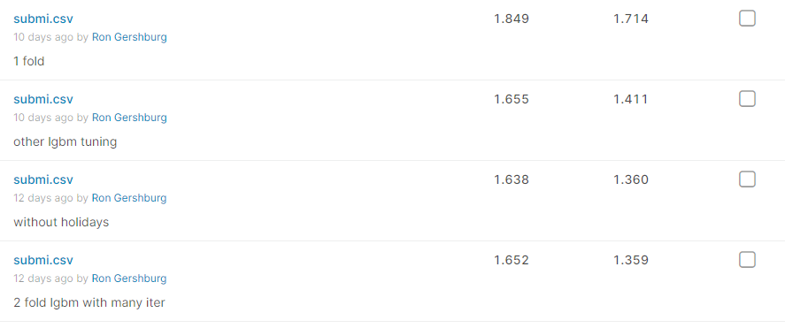
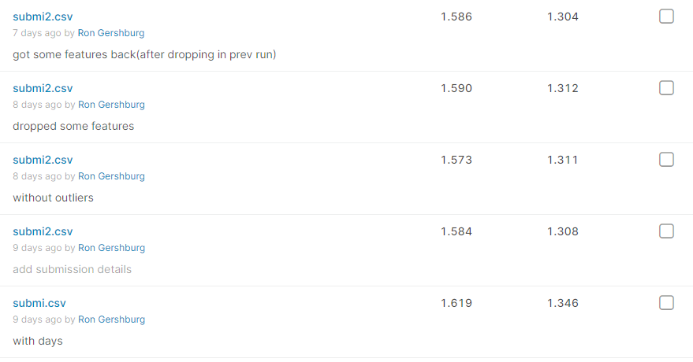
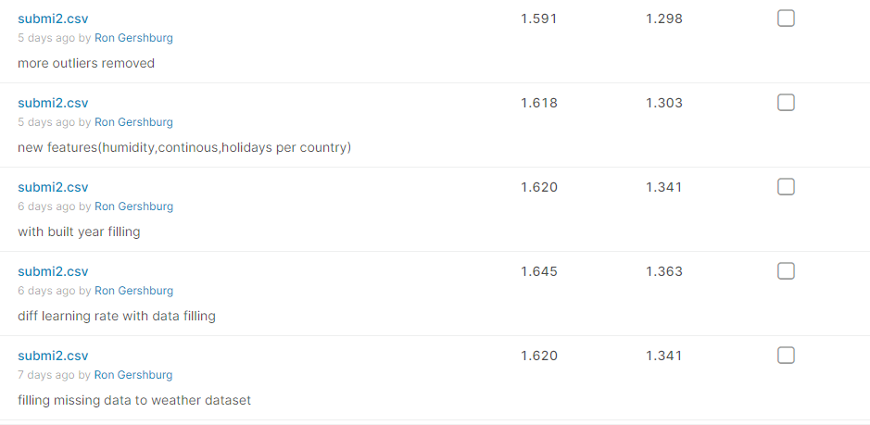
Results

Slide 14
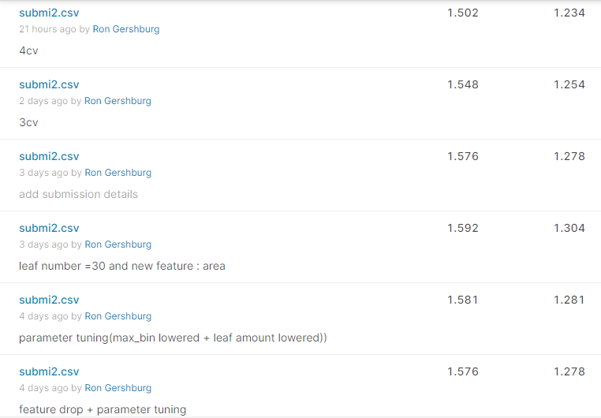
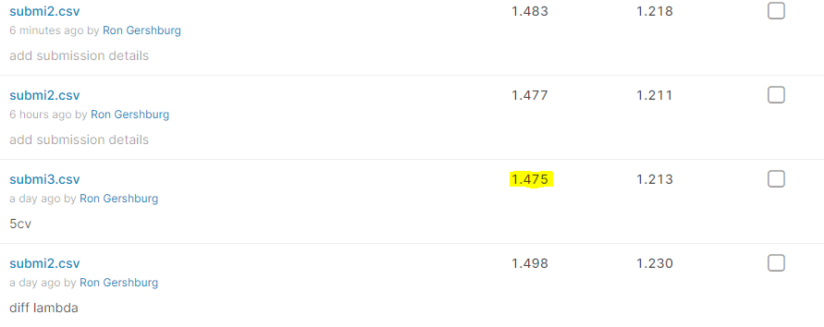
Results

Slide 15
Conclusions
Overfitting has affected our results. In order to deal with it we increased the value of λ in our model and changed tree size (num_leaves). By raising λ and decreasing tree size we simplified the model and got better predictions.
Our model’s score was affected mostly by:
changing the value of k in k-cross validation.
removing outliers.
At the beginning we had tried to use lasso model, but model performance was poor in comparison to GBDT.
Filling missing values in features that lacked values, didn’t benefit model performance.
Our best model has produced the private score of 1.475 .

